Slide 1

Airbus
Aerothon 6.0
Idea pitching slide

Slide 2
Yet another airline CRM
A webapp to streamline the repair and routine maintenance of Airbus planes operated by an airline
An ML to analyse aircraft health based CV models that analyse aircraft live images
Performs necessary automated checks before journey to avoid delays and provide on time repairs if needed
All MRO vendors at one single place

Slide 3


Problem statement
Problem-1
Problem-2
An XYZ airline Airbus A320 from Delhi is about to land on terminal-2 of Bangalore airport
The same airplane will be flying back to Delhi within next 2 hours carrying 180 passengers and 8 crew
What about aircraft regular maintenance, flight history, health check and effective cost of these repairs
How can the airline reduce the repair and maintenance expenditures while maintaining minimum delays?
How can I reach to all my MROs with sufficient data?
What if we need more support? Do we already have all parts to fix the damage

Slide 4
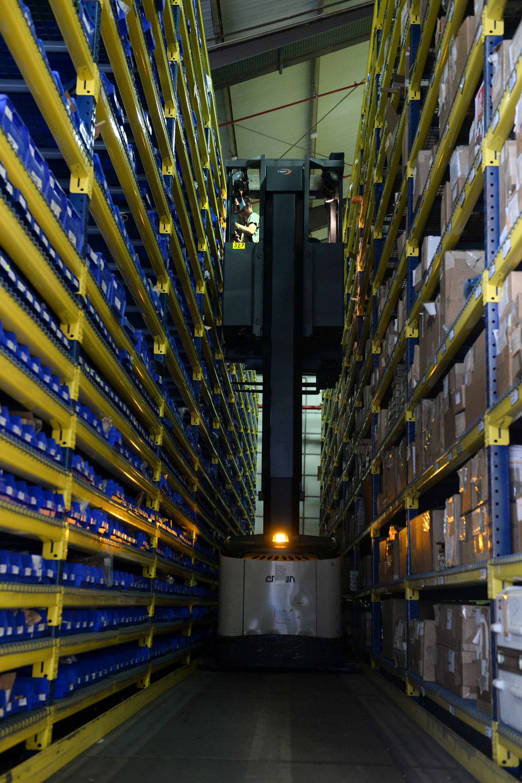

Solution-1
Luckily the plane is equipped with state-of-the-art damage detection systems that takes aircraft images from different parts to identify any dents …. Once the aircraft reaches the network area the data is sent to the warehouse and ground staff
Damage detection model
Required parts will be sent on time
Warehouse

Slide 5

Solution-2
It’s time for routine aircraft maintenance, our maintenant vendor might take 2 days to analyse and reply back with exact ETAs
But no more, with our Yet-another-CRM you can maintain MRO relations and ask for an ETA by sharing aircraft’s latest images and health reports
The vendor may even provide us with minimum time taking on site repairs at just 1/10th price.
But where to find this data?
Healthcheck
Recently completed flights
Damage and repair history
Maintenance history
Latest images analysed by CV models
MRO
No worries, we can send timely help at your doorstep. No need to stop your flights

Slide 6
Flight Analytics
Repair history analysis:
At which airport we experienced more damages?
A -> B (prior data) 40% damage Airpot A
Which part requires more replacements?
Opening gate motors: repair staff : > Airbus will handle
Which MRO is best for our operations?
MRO vendors: which was the best in terms of on time delivery of planes
Cost effective
Monitoring most time spent:
Monitor the ground staff capability to fix any particular issue and train staff on required basis
Ground staff is not able to handle wings related
Integrate with your ERP solutions to let HRs know which required skill is a bottleneck for efficient ground staff operations
What skill set based HR need to hired
Send data to Airbus
Customers can now send a feedback to Airbus on their flight past repair history to help them circle around the area of concern

Slide 7
MRO Vendor Onboarding
Airlines will be provided an option to onboard MRO vendors
These vendors can then be reached out with proper data on the same platform and the one with minimum turnaround time and with least fares and good reviews can be assigned the repair task
Vendors will also get a platform to analyse the aircraft images before hand to order any required parts before the aircraft arrives for repair work
Vendors can now send their estimates and receive the confirmation on the same platform

Slide 8
Compliance and Health Check
Airlines can run automated health checks for their aircrafts and meet the required compliance standards
What could be missed from a person’s eye will still be caught on the monitoring systems
Maintaining timely compliance checks and centrally recording these data, airlines can be transparent to their users and regulatory authorities

Slide 9
ML, Data science and CRM
The CV model that identifies the dents
Data analytics to surface out possible bottlenecks and areas of savings
CRM to integrate all of this at one single place
Furthermore, airlines can even integrate these with ERP solutions to drive HR, purchase, billing and booking departments

Slide 10
More ideas
Classification algorithms at the ground staff inputs and vendor end to group the repair work can be useful to generate analytics
Some use case of generative AI can be leveraged
Some image-to-text LLM solution
…..

Slide 11
Team base234
Arnab: CV models part
Shruti: Data analytics and presentation on UI
Vaibhav: React frontend
Nilesh: Design document and ER diagram and API document

